Slide 1
Cloud Computing
SEWP ZG527

Slide 2
Inside OpenNebula
Notes:
RL 6.4

Slide 3
OpenNebula Architecture

Slide 4
The Core
Request manager: Provides a XML-RPC interface to manage and get information about ONE entities.
SQL Pool: Database that holds the state of ONE entities.
VM Manager (virtual machine): Takes care of the VM life cycle.
Host Manager: Holds handling information about hosts.
VN Manager (virtual network): This component is in charge of generating MAC and IP addresses.

Slide 5
The tools layer
Scheduler:
Searches for physical hosts to deploy newly defined VMs
Command Line Interface:
Commands to manage OpenNebula.
onevm: Virtual Machines
create, list, migrate…
onehost: Hosts
create, list, disable…
onevnet: Virtual Networks
create, list, delete…

Slide 6
The drivers layer
Transfer Driver: Takes care of the images.
cloning, deleting, creating swap image…
Virtual Machine Driver: Manager of the lifecycle of a virtual machine
deploy, shutdown, poll, migrate…
Information Driver: Executes scripts in physical hosts to gather information about them
total memory, free memory,
total #cpus, cpu consumed…

Slide 7
Process separation
Scheduler is a separated process, just like command line interface.
Drivers are also separated processes using a simple text messaging protocol to communicate with OpenNebula Core Daemon (oned)

Slide 8
Constructing a private cloud

Slide 9
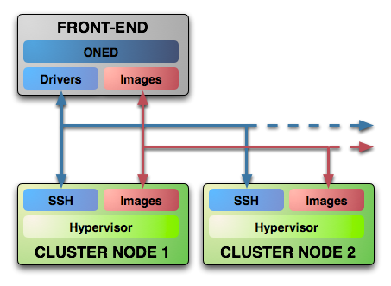
System Overview
Executes the OpenNebula Services
Usually acts as a classical cluster front-end
Repository of VM images
Multiple backends (LVM, iSCSI..)
Modular components to interact with the cluster services
Types: storage, monitoring, virtualization and network
The same host can be can be a the front-end and a node
Provides physical resources to VMs
Must have a hypervisor installed

Slide 10
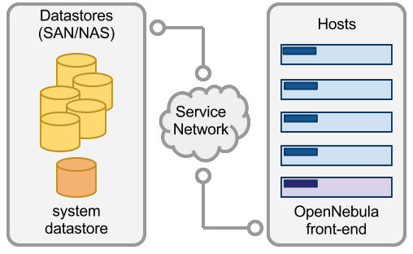
Complex Storage behind OpenNebula
Storage
Virtual machines and their images are represented as files
Datastore | Transfer Manager Drivers
 | shared | ssh | iscsi | qcow | vmware
System | OK | OK
File-System | OK | OK |  | OK
iSCSI |  |  | OK
VMware | OK | OK |  |  | OK
Virtual machines and their images are represented as block devices (just like a disk)

Slide 11
System Datastore with Shared Transfer Manager Driver
Storage
System
Datastore

Slide 12
Preparing the storage for a simple private cloud
Storage
Image Repository (system datastore): Any storage medium for the VM images (usually a high performing SAN)
OpenNebula supports multiple back-ends (e.g. LVM for fast cloning)
The front-end must have access to the repository
VM Directory: The home of the VM in the cluster node
Stores checkpoints, description files and VM disks
Actual operations over the VM directory depends on the storage medium
Should be shared for live-migrations
You can go on without a shared FS and use the SSH back-end
Defaults to $ONE_LOCATION/var/$VM_ID
Dimensioning the Storage... Example: A 64 core cluster will typically run around 80VMs, each VM will require an average of 10GB of disk space. So you will need ~800GB for /srv/cloud/one, you will also want to store 10-15 master images so ~200GB for /srv/cloud/images. A 1TB /srv/cloud will be enough for this example setup.

Slide 13
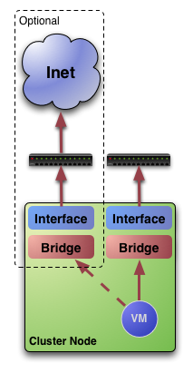
Networking for private clouds
Network
OpenNebula management operations use ssh connections
Image traffic, may require the movement of heavy files (VM images, checkpoints). Dedicated storage links may be a good idea
VM demands, consider the typical requirements of your VMs. Several NICs to support the VM traffic may be a good idea
OpenNebula relies on bridge networking for the VMs

Slide 14
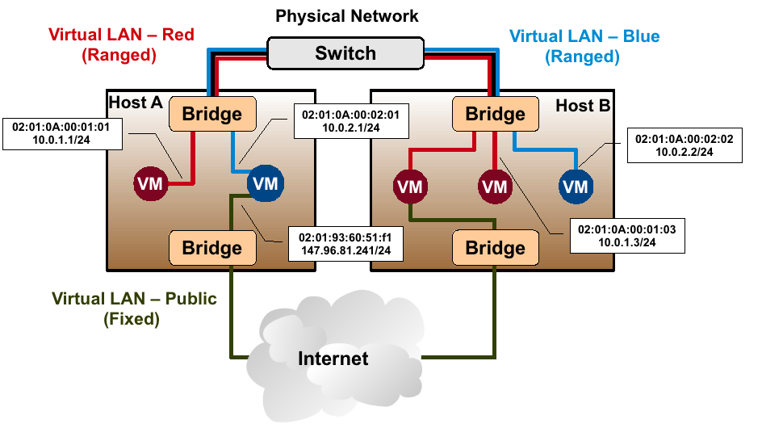
Example network setup in a private cloud
Network

Slide 15
Virtual Networks
Network
A Virtual Network in OpenNebula
Defines a separated MAC/IP address space to be used by VMs
Each virtual network is associated with a physical network through a bridge
Virtual Networks can be isolated (at layer 2 level) with ebtables and hooks
Virtual Networks are managed with the onevnet utility

Slide 16
Users
Users
A User in OpenNebula
Is a pair of username:password
Only oneadmin can add/delete users
Users are managed with the oneuser utility

Slide 17
User Management
Users
Native user support since v1.4
oneadmin: privileged account
Usage, management, administrative rights for:
Templates, VMs, Images, Virtual Networks
Through ACLs further operations/rights are available:
Rights for users, groups, datastores and clusters
Creation operation
SHA1 passwords (+AA module)
Stored in FS
Alternatively in environment

Slide 18
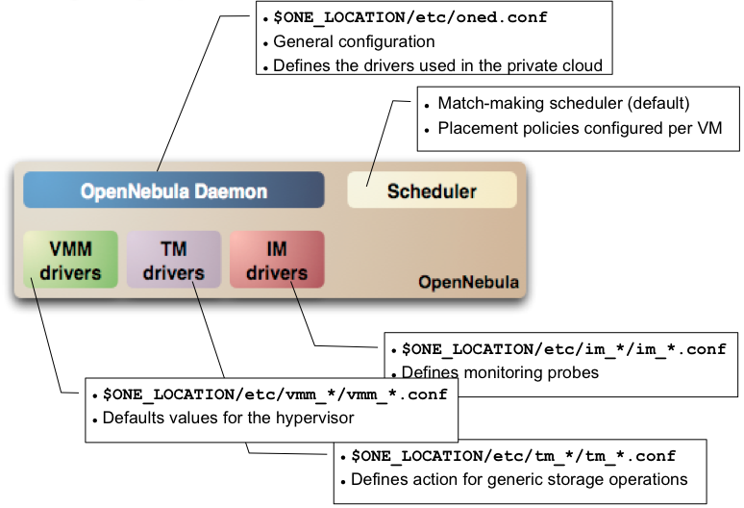
Configuration

Slide 19
Virtual machines

Slide 20
Preparing VMs for OpenNebula
VMs
Virtual Machines are managed with the oneuser utility
You can use any VM prepared for the target hypervisor
Hint I: Place the vmcontext.sh script in the boot process to make better use of vlans
Hint II: Do not pack useless information in the VM images:
swap. OpenNebula can create swap partitions on-the-fly in the target host
Scratch or volatile storage. OpenNebula can create plain FS on-the-fly in the target host
Hint III: Install once and deploy many; prepare master images
Hint IV: Do not put private information (e.g. ssh keys) in the master images, use the CONTEXT
Hint V: Pass arbitrary data to a master image using CONTEXT

Slide 21
VM Description
VMs
Option | Description
NAME | Name that the VM will get for description purposes.
CPU | Percentage of CPU divided by 100 required for the Virtual Machine.
OS (KERNEL, INITRD) | Path of the kernel and initrd files to boot from.
DISK (SOURCE, TARGET, CLONE, TYPE) | Description of a disk image to attach to the VM.
NIC (NETWORK) | Definition of a virtual network the VM will be attached to.
Multiple disk an network interfaces can be specified just adding more disk/nic statements.
To create swap images you can specify TYPE=swap, SIZE=<size in MB>.
By default disk images are cloned, if you do not want that to happen CLONE=no can be specified and the VM will attach the original image.

Slide 22
VM States overview
VMs

Slide 23
Pending state
VMs
After submitting a VM description to ONE it is added to the database and its state is set to PENDING.
In this state IP and MAC addresses are also chosen if they are not explicitly defined.
The scheduler awakes every 30 seconds and looks for VM descriptions in PENDING state and searches for a physical node that meets its requirements. Then a deploy XML-RPC message is sent to oned to make it run in the selected node.
Deployment can be also made manually using the Command Line Interface:
onevm deploy <vmid> <hostid>

Slide 24
Prolog state
VMs
In PROLOG state the Transfer Driver prepares the images to be used by the VM.
Transfer actions:
CLONE: Makes a copy of a disk image file to be used by the VM. If Clone option for that file is set to false and the Transfer Driver is configured for NFS then a symbolic link is created.
MKSWAP: Creates a swap disk image on the fly to be used by the VM if it is specified in the VM description.

Slide 25
Boot state
VMs
In this state a deployment file specific for the virtualization technology configured for the physical host is generated using the information provided in the VM description file. Then Virtual Machine Driver sends deploy command to the virtual host to start the VM.
The VM will be in this state until deployment finishes or fails.

Slide 26
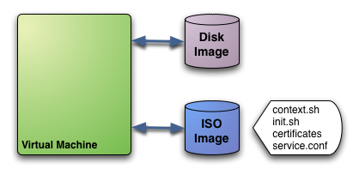
Contextualization
VMs
The ISO image has the contextualization for that VM:
context.sh: contains configuration variables
init.sh: script called by VM at start to configure specific services
certificates: directory that contains certificates for some service
service.conf: service configuration
User provided, OpenNebula provided contextualization info

Slide 27
Running and Shutdown states
VMs
While the VM is in RUNNING state it will be periodically polled to get its consumption and state.
In SHUTDOWN state Virtual Machine Driver will send the shutdown command to the underlying virtual infrastructure.

Slide 28
Epilog state
VMs
In EPILOG state the Transfer Manager Driver is called again to perform this actions:
Copy back the images that have SAVE=yes option.
Delete images that were cloned or generated by MKSWAP.

Slide 29
Hybrid cloud

Slide 30
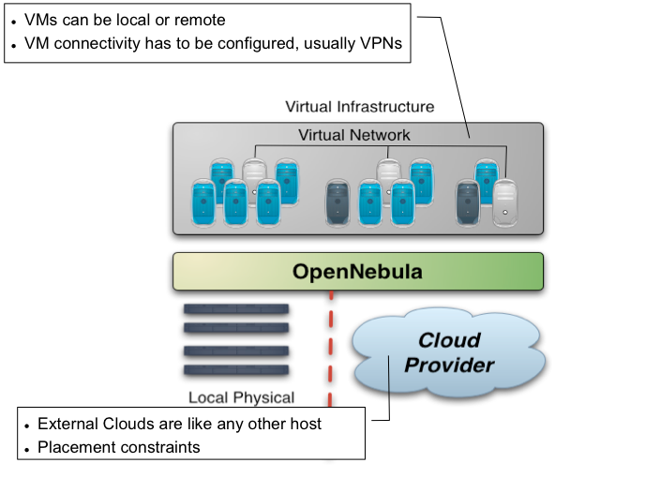
Overview

Slide 31
Making an Amazon EC2 hybrid
Amazon EC2 cloud is managed by OpenNebula as any other cluster node
You can use several accounts by adding a driver for each account (use the arguments attribute, -k and -c options). Then create a host that uses the driver
You can use multiple EC2 zones, add a driver for each zone (use the arguments attribute, -u option), and a host that uses that driver
You can limit the use of EC2 instances by modifying the IM file
Notes:
Create your EC2 hybrid cloud by adding a new host
$ onehost create ec2 im_ec2 vmm_ec2 tm_dummy
$ onehost list
ID NAME RVM TCPU FCPU ACPU TMEM FMEM STAT
0 84.21.x.y 0 200 200 200 2017004 1667080 on
1 84.21.x.z 1 200 200 200 2017004 1681676 on
2 ec2 0 500 500 500 8912896 8912896 on

Slide 32
Using an EC2 hybrid cloud
Virtual Machines can be instantiated locally or in EC2
The VM template must provide a description for both instantiation methods.
The EC2 counterpart of your VM (AMI_ID) must be available for the driver account
The EC2 VM template attribute should describe not only the VM’s properties but the contact details of the external cloud provider

Slide 33
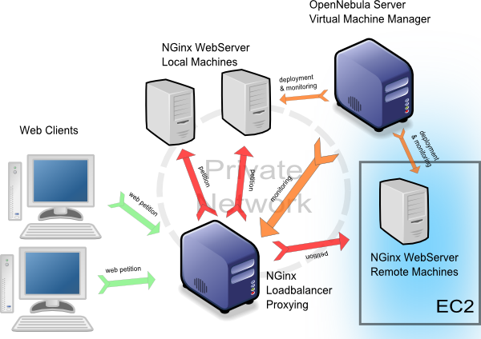
Hybrid cloud Use Case
On-demand Scaling of Computing Clusters
On-demand Scaling of Web Servers
Elastic execution of the NGinx web server
The capacity of the elastic web application can be dynamically increased or decreased by adding or removing NGinx instances
Notes:
In order to illustrate the functionality provided by OpenNebula, we have developed some use cases. For example:
On-demand…. That is the …This use case demonstrates the dynamic,,,
On-demand… That is the … This use case illustrates how

